Slide 1
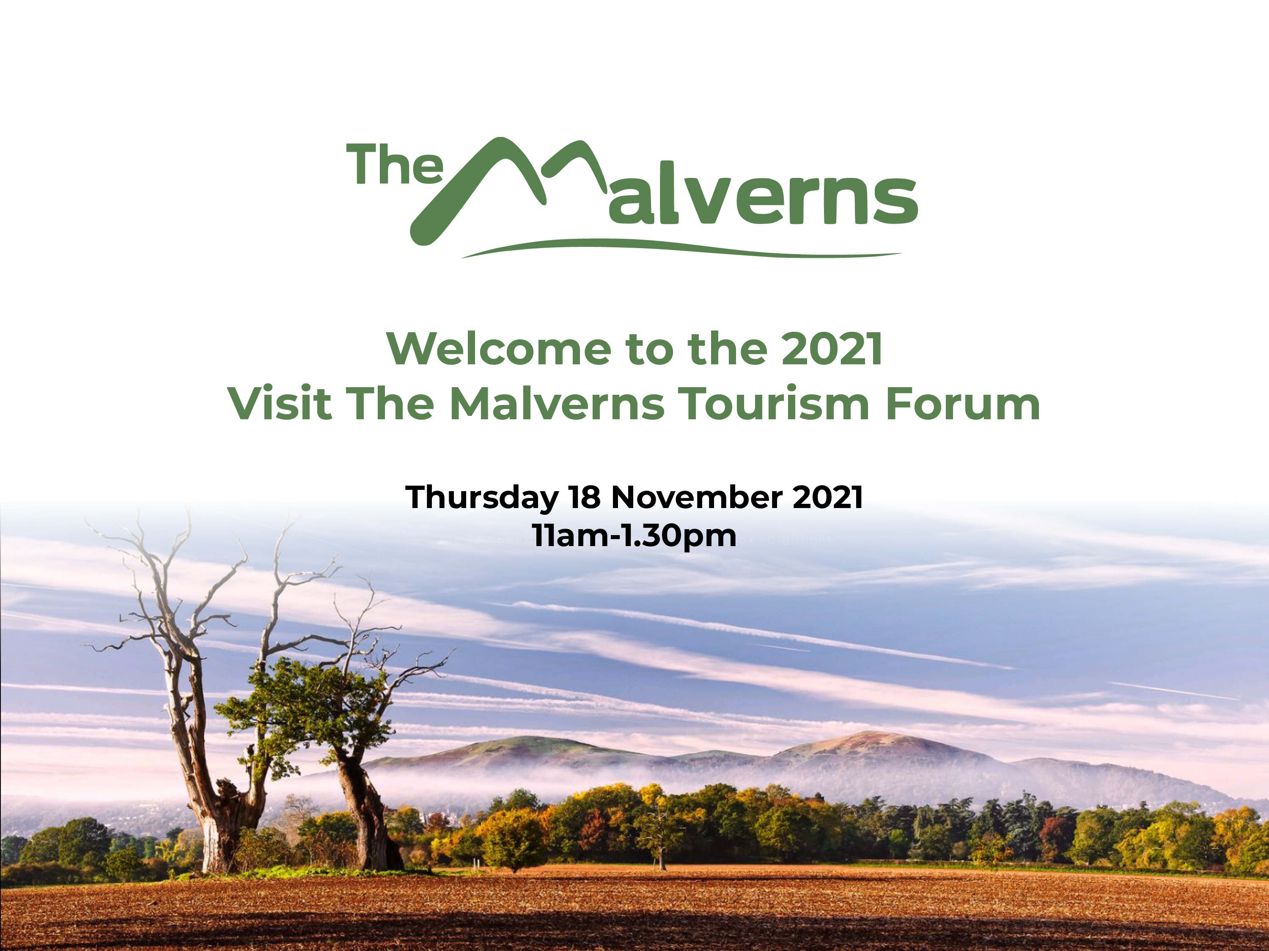

Slide 2

WELCOME
Steve Morris
Morgan Motor Factory and
NEW
Experience Centre

Slide 3

WELCOME
Councillor Daniel Walton
Malvern Hills District Council

Slide 4
2021 Tourism Forum Agenda
11am Registration with tea, coffee and networking
11:35am Introduction to the Morgan Motor Company by Steve Morris
11:40am Welcome to the Tourism Forum by Councillor Daniel Walton
11:45am Visit the Malverns update by Victoria Carman
12:00pm Malvern Hills District Council Destination Zero update by Matthew Barker
12:15pm The New Reality of Tourism in a Competitive World by Rebecca Hawkins at RHP Ltd
1:05pm Launch of Visit The Malverns new Sustainable Tourism Grant Scheme
1:15pm Q&A
1:30pm Morgan Motor Factory tours and Networking

Slide 5
Visit The Malverns Update
Challenging 18 months for the tourism and hospitality industry
EU Covid-19 grant support administered via Malvern Hills District Council
Welcome Back Fund for Town Centre Recovery
Online survey for then new Town Centre Transformation Plans

Slide 6


Visit The Malverns Branding
New Brand Guidelines with refreshed logos and new colours and fonts.
Partner with us by adding our logo to your website with web link.
New image partner - Jan Sedlacek from Digitlight Photography.
Tourism businesses can access Jan Sedlacek’s images but must stipulate copyright.

Slide 7
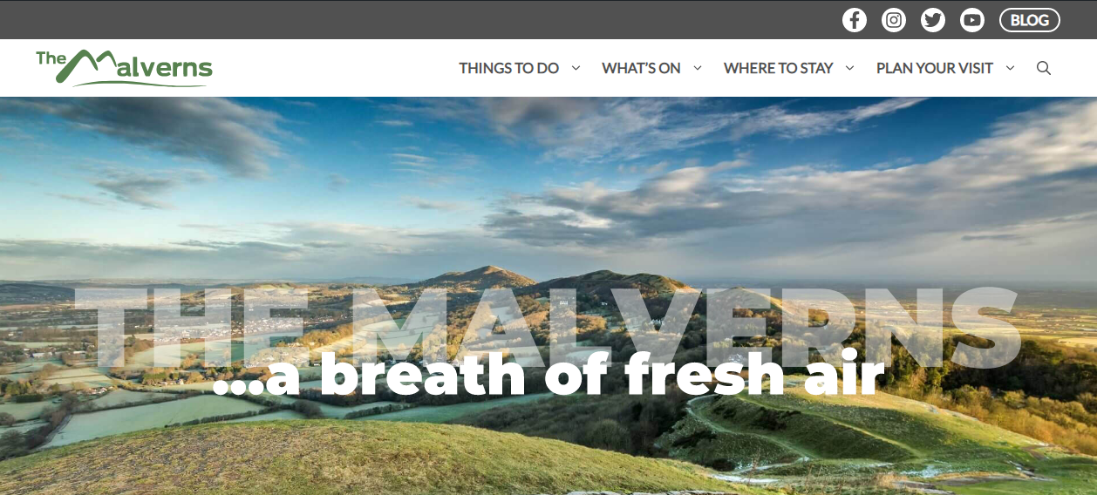
Visit The Malverns Website

Slide 8
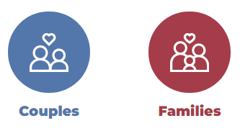
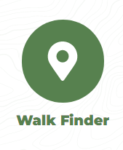
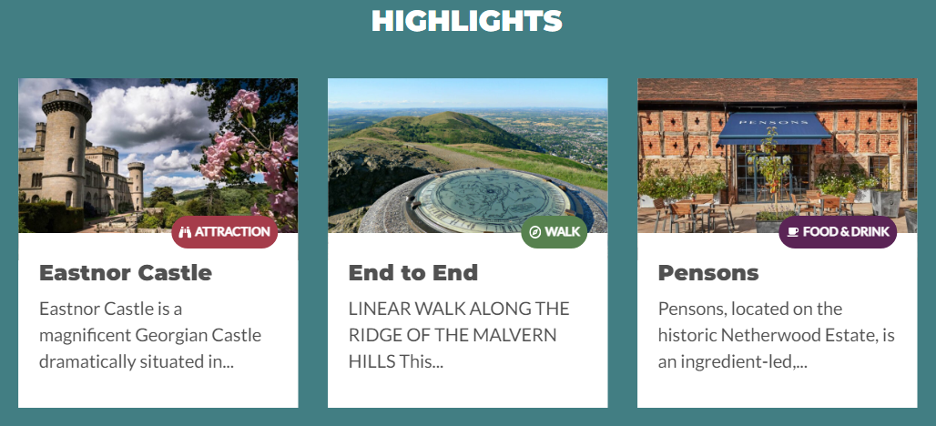


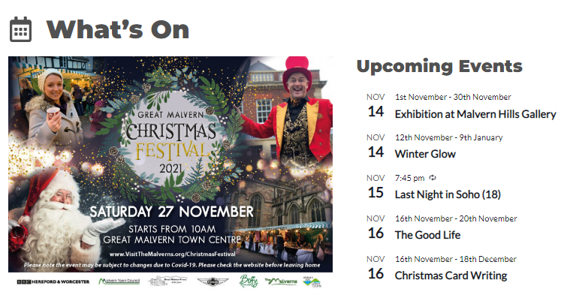
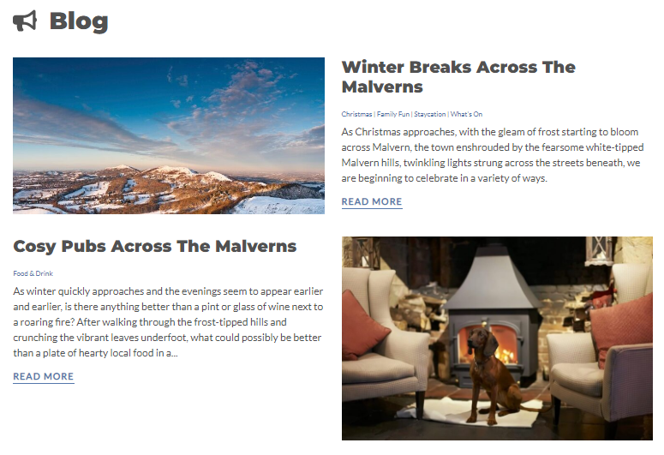
Visit The Malverns Website

Slide 9
Visit The Malverns Website
Refreshed design with new branding, images and improved accessibility.
Approx. 40,000 visits/sessions per month, 1 million page views since April 2021.
Top ranking pages – Walking, Things To Do, Attractions, What’s On and Accommodation.
Increased Accessibility Score – Homepage - 100% Google Accessibility Score
Ranked top in Google organic search results for Where To Stay, Things To Do, What’s On and Food and Drink.
Acquisition – Google Organic Search, Direct and Social Media
Free website listings for Attractions, Accommodation, Events and Eateries. Is your business featured?

Slide 10


Visit The Malverns Social Media
www.facebook.com/visitthemalverns
Followers – 10,154
Jan – November 2021 Reach – 2,570,987
Jan – November 2021 Engagement – 73,620
www.Instagram.com/visitthemalverns
Followers – 2551
Good post engagement but more time required on content creation to help increase followers.
Unfortunately we can’t monitor engagement for free.
Coming up…
New video content for our YouTube channel and social media platforms.

Slide 11
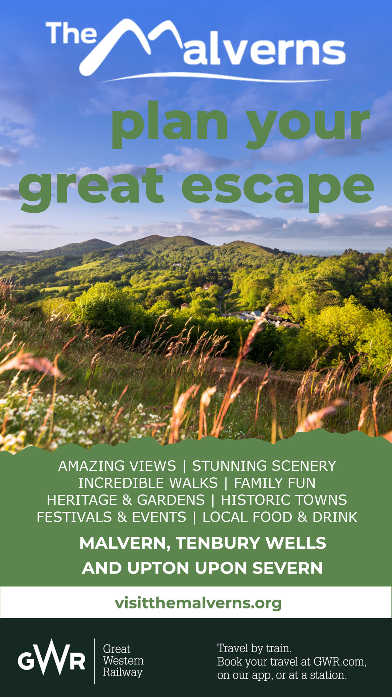
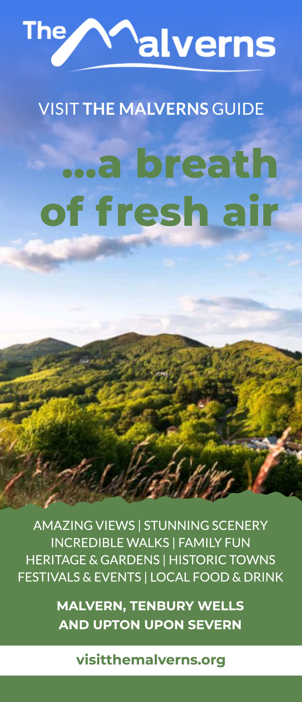
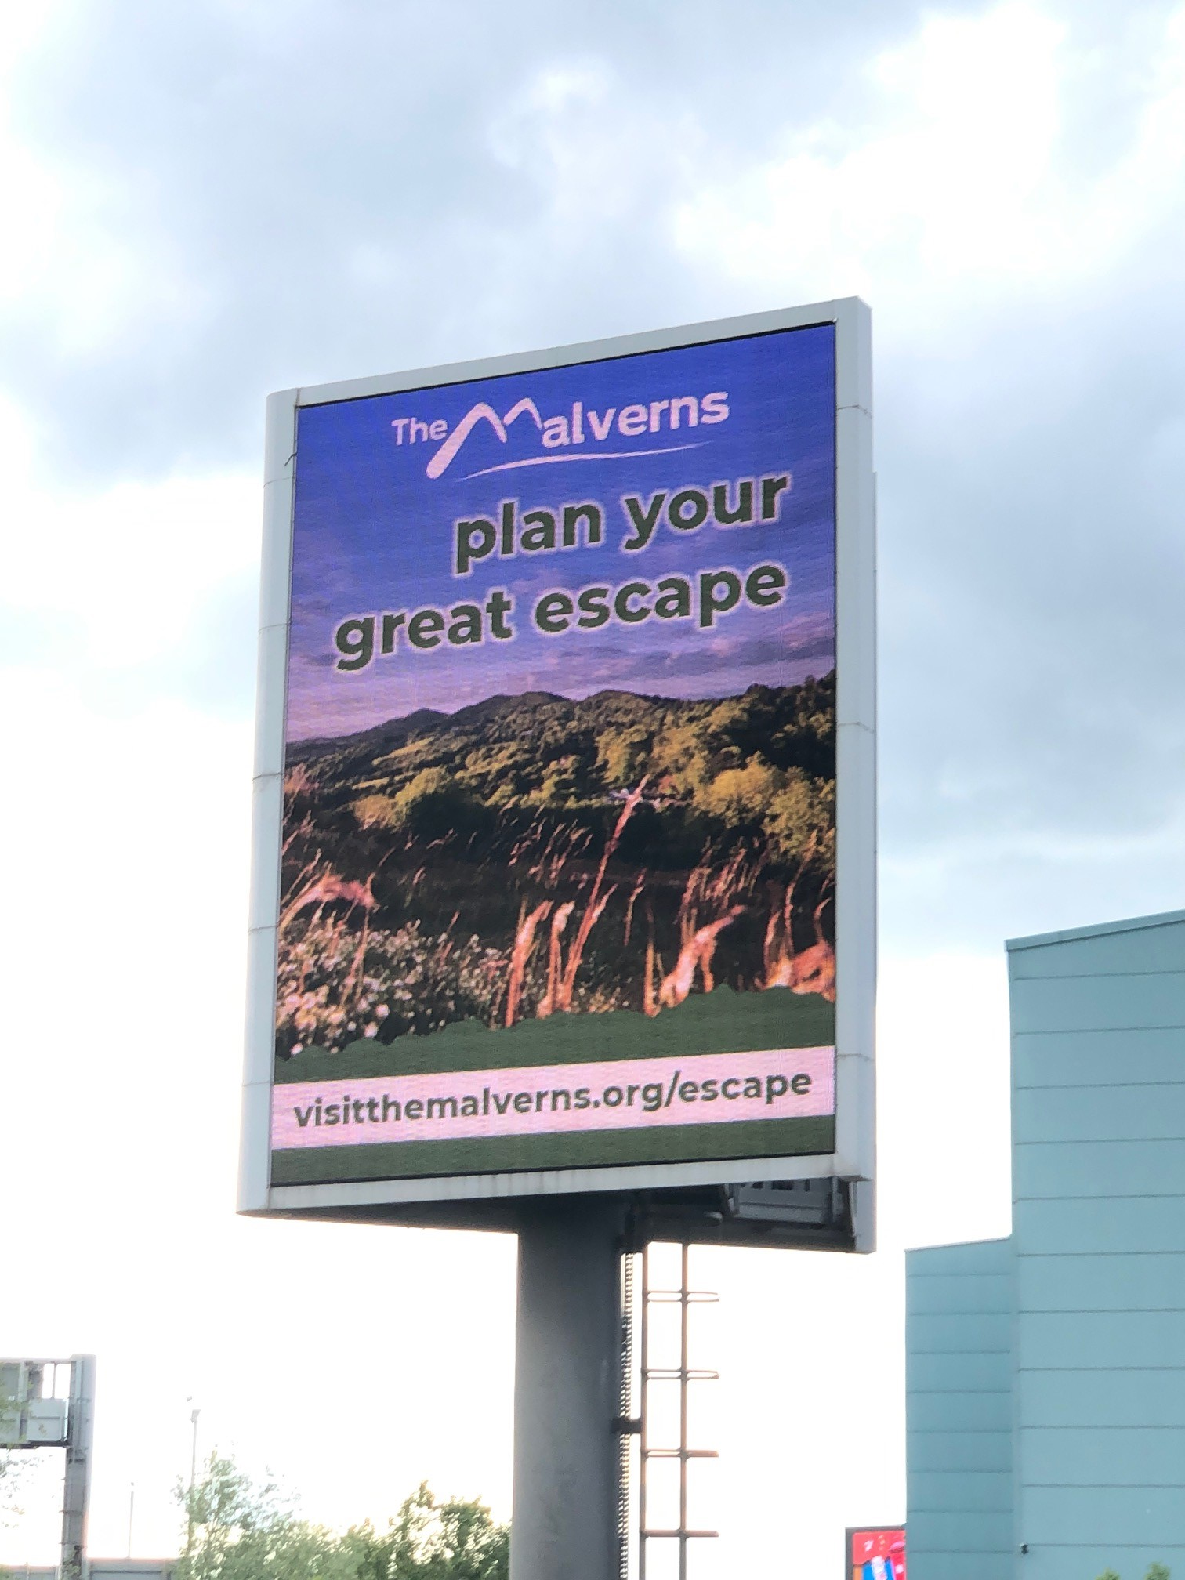
Plan Your Great Escape – Staycation Breaks Campaign

Slide 12






Staycation Breaks Campaign – National Newspaper Features
Walking has never been more popular - most beautiful walks in the UK named | Travel News | Travel | Express.co.uk
UK's top 10 prettiest countryside walks including Brecon Beacons and the Peak District - Mirror Online
https://www.thetimes.co.uk/article/the-uks-best-spa-town-breaks-h26hnrsc8
20 of the best autumn escapes around the UK | United Kingdom holidays | The Guardian
https://www.independent.co.uk/travel/uk/british-bucket-list-experiences-adventures-b1842559.html

Slide 13
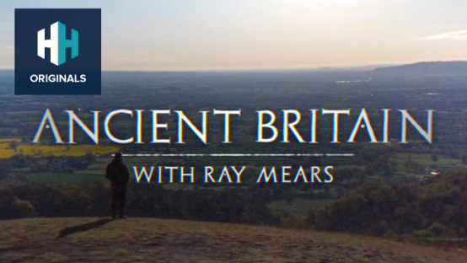
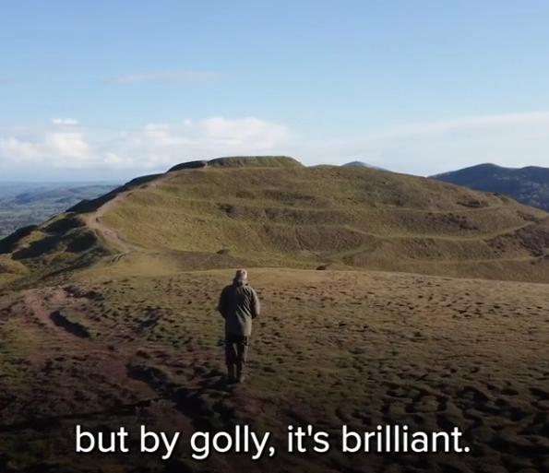
Staycation Breaks Campaign – TV

Slide 14
Staycation Breaks Campaign Statistics
Visit The Malvern Website – 1 April 2021 – 31 August 2021
Website Visits/Sessions = 212,331 (+52% on 2020 and +38% on 2019)
Page Views – 700,601 (+46% on 2020 and +28% on 2019)
1 April – mid-July 2021
Walking Route Downloads – 29,148
Business Link Clicks – Approx. 27,500
Facebook
Sponsored Advertising Reach – 1,971,814
Organic Reach – 212, 729
Total Reach – 2,184,543
Engagement – 51,946
Engagement Rate – 2.38% - Above 1% is deemed good.

Slide 15

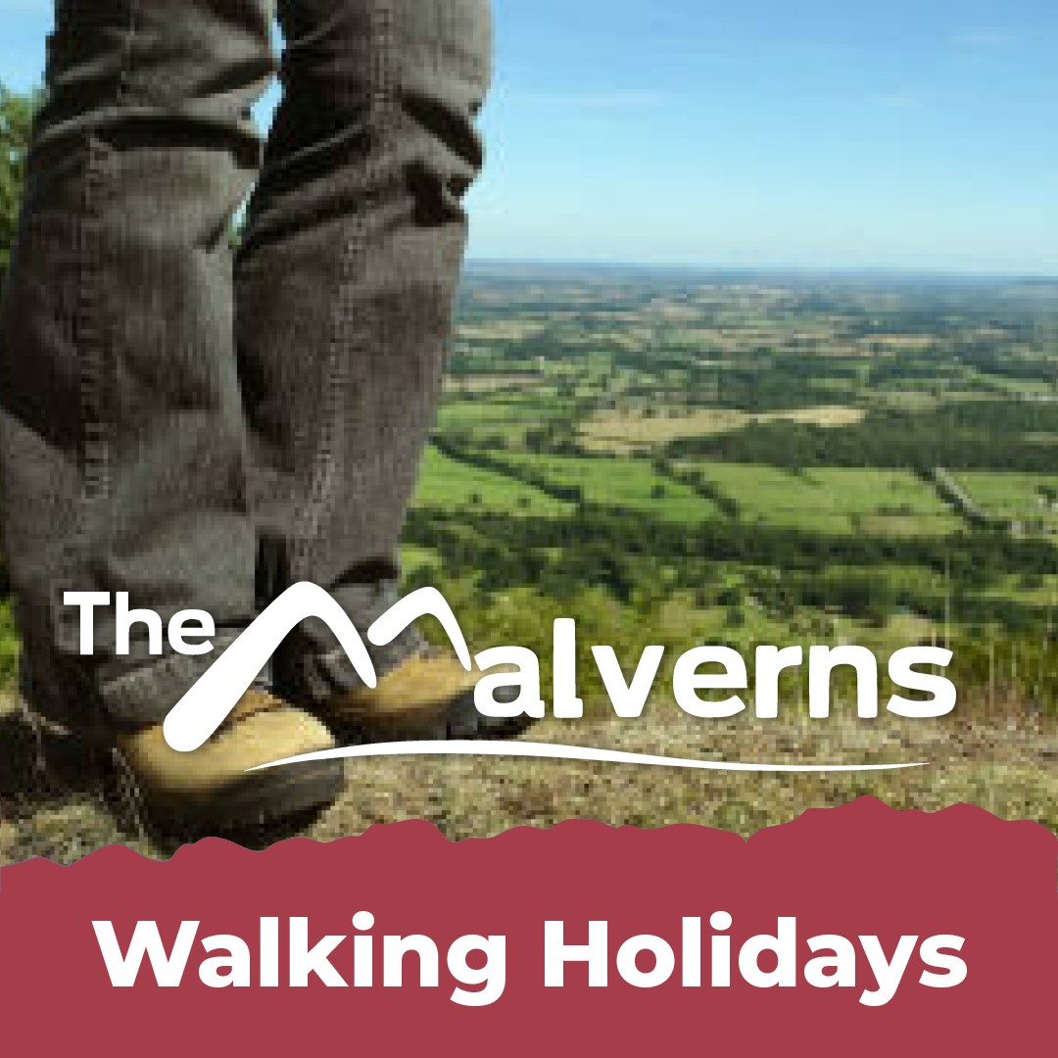

Health & Wellbeing Breaks Campaign

Slide 16
Health & Wellbeing Breaks Campaign

Slide 17
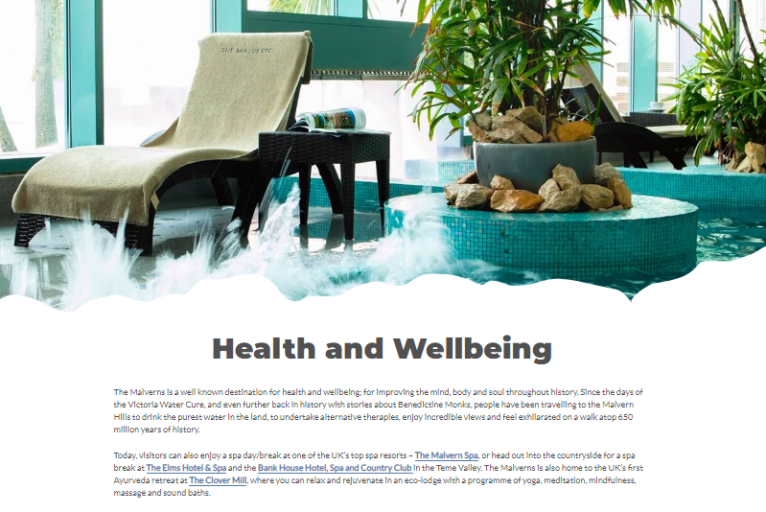
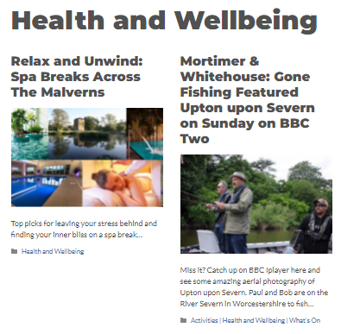
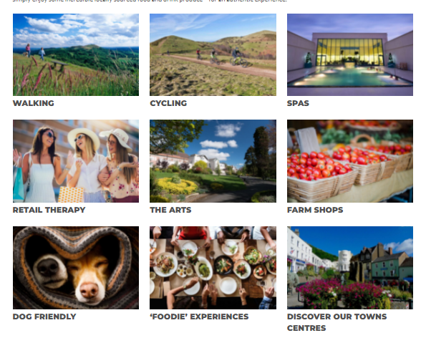
Health & Wellbeing Breaks Campaign

Slide 18
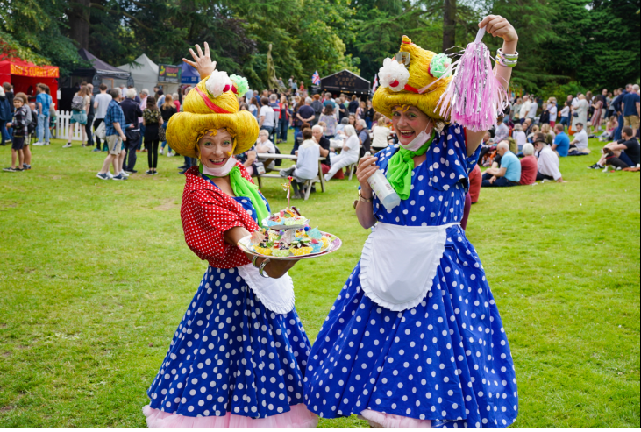
2021 Visit The Malverns Event Dev.
Malvern Walking Festival – 28 May – 5 June 2021
Midsummer Malvern Festival – 19-27 June 2021
Science in the Park – 26 June 2021
Great Malvern Food Festival – moved to new dates 10-11 July 2021 & hosted in Priory Park
Great Malvern Gin Fest – 20-22 August 2021
Heritage Open Week – 10-19 September 2021
Festival of Equality in Arts and Society through Theatre - 20-28 September 2021
Upton Day of Jazz – Saturday 2 October 2021
Malvern Festival of Innovation – 4-9 October 2021
Morris & Creatures – 16-17 October 2021
Upton upon Severn Pumpkin Trail – 29-30 October 2021
Hocus Pocus Outdoor Cinema – 30 October 2021
Elgar Festival – 29-31 October 2021
Coming up…
Great Malvern Christmas Festival – Saturday 27 November 2021
Tenbury Wells Christmas Markets – Thursday 9 December 2021

Slide 19
What’s Next?
BBC Countryfile – filming a one hour TV programme.
2022 Commonwealth Games in Birmingham – Free customer service training for businesses across the region.
Lonely Planet Guide large feature planned – press visit opportunity.
The Chronicles of Malvernia - New Myths, Tales and Legends Walking Stories – JRR. Tolkien, C.S Lewis and Caratacus etc.
New and improved Teme Valley Walks.
Festival and Event Development for Town Centres.
Refreshed 2022 Visit The Malverns Guide.
Visit Worcestershire Marketing Campaigns
Community Renewal Fund £250,000 – MHDC Skills questionnaire being sent out in December 2021.
2020 Economic Impact Assessment for the district and Worcestershire.
Sustainable Tourism Project Launch – find out more later…..
Here2Help Grants

Slide 20


Slide 21
THANK YOU
Victoria Carman
Visitor Economy Officer
Malvern Hills District Council
01684 862483
victoria.carman@malvernhills.gov.uk

Slide 22
Sustainable Tourism Project Launch
- Malvern Hills District Council declared a Climate Emergency in July 2019.
The Destination Zero: Creating a greener and more sustainable Malvern Hills District was approved in January 2020.
Visitor Economy Action Plan with sustainable tourism a priority approved in January 2021.
Research, drafts and business feedback.
Simplified the process and refined outputs.
Providing a starting point for tourism businesses to get on board.
Aims to create a likeminded local Sustainable Tourism Business Community.

Slide 23

Sustainable Tourism Grants
Overview of the scheme
The Sustainable Tourism Grant Scheme will provide funding that will be used towards expenditure that supports environmental sustainability.
Grants of between £500-£2,500 are available but the grant must be match-funded 50%, pound for pound (at least), from the business’s own resources.
The scheme will pay towards green infrastructure, tools/machinery, energy audits, composters, electric car charging points, as well as the fees for accreditation via the Green Tourism Business Scheme.

Slide 24

Green Tourism Toolkit
Top tips on how to adopt sustainable practices for:
- Energy
- Water
- Community
- Travel
- Natural Environment
- Waste & Purchasing

Slide 25

Green Mark: A Commitment For Adopting Greener Practices
Take The Quiz
Get an idea of your current green credentials
A member of the team will contact you to have a chat about your business
Businesses who are leaders in sustainability and can successfully demonstrate it, will receive the Green Mark
Businesses become part of a local green tourism business community.

Slide 26

Green Tourism Business Scheme
Be internationally recognised for your green tourism business actions.
Discounts are available for tourism businesses located across The Malverns.
Grants are available to help cover 50% of the cost.

Slide 27


Business Energy Efficiency Programme (BEEP)
Energy audits and assessments
Grants up to £20,000 dependent on eligibility

Slide 28
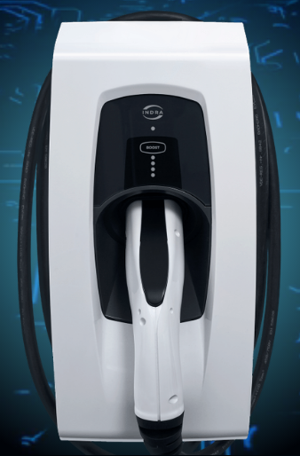
Local ‘Green’ Suppliers
Indra – Electric Vehicle Charging points –
Worlds smartest charger
Best reliability in the market
Innovative company, designing and Mandy curing in Malvern
Easy to use
Discounts available for businesses operating in The Malverns and taking out our grants.
Bubblehouse Wormeries – turn your food waste into compost with worms. Based in Bransford.

Slide 29
THANK YOU
Q&A
www.visitthemalverns.org/sustainability

Slide 30
THANK YOU
Victoria Carman
Visitor Economy Officer
Malvern Hills District Council
01684 862483
victoria.carman@malvernhills.gov.uk

